Slide 1
Verilog

Slide 2
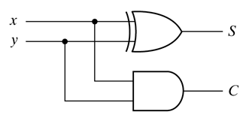
Hierarchical Design
  Will show the hierarchical design approach using an example:
  A 4-bit adder in terms of full-adders
  Full-adders in terms of half-adders
  Half-adders in terms of gates
//HDL Example 4-2
//-----------------------------------------------
//Gate-level hierarchical description of 4-bit adder
// Description of half adder (see Fig 4-5b)
module halfadder (S,C,x,y);
input x,y;
output S,C;
//Instantiate primitive gates
xor (S,x,y);
and (C,x,y);
endmodule

Slide 3
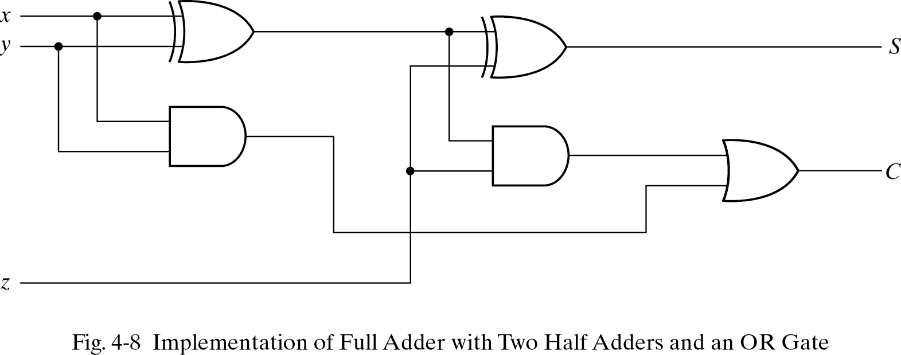
Hierarchical Design
//Description of full adder (see Fig 4-8)
module fulladder (S,C,x,y,z);
input x,y,z;
output S,C;
wire S1,D1,D2; //Outputs of first XOR and two AND gates
//Instantiate the halfadder
halfadder HA1 (S1,D1,x,y),
HA2 (S,D2,S1,z);
or g1(C,D2,D1);
endmodule
//HDL Example 4-2
//-----------------------------------------------
//Gate-level hierarchical description of 4-bit adder
// Description of half adder (see Fig 4-5b)
module halfadder (S,C,x,y);
input x,y;
output S,C;
//Instantiate primitive gates
xor (S,x,y);
and (C,x,y);
endmodule
S1
D1
D2

Slide 4
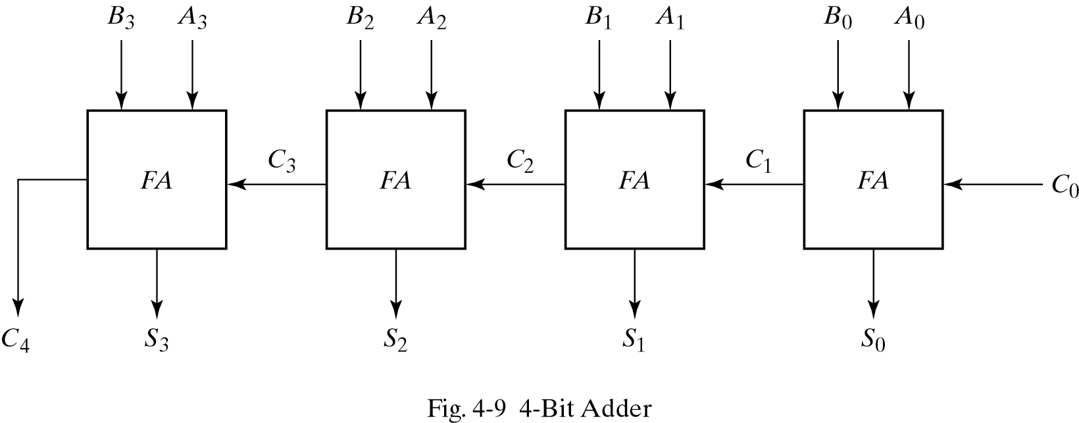
Hierarchical Design
//Description of 4-bit adder (see Fig 4-9)
module _4bit_adder (S,C4,A,B,C0);
input [3:0] A,B;
input C0;
output [3:0] S;
output C4;
wire C1,C2,C3; //Intermediate carries
//Instantiate the fulladder
fulladder FA0 (S[0],C1,A[0],B[0],C0),
FA1 (S[1],C2,A[1],B[1],C1),
FA2 (S[2],C3,A[2],B[2],C2),
FA3 (S[3],C4,A[3],B[3],C3);
endmodule
//Description of full adder (see Fig 4-8)
module fulladder (S,C,x,y,z);
input x,y,z;
output S,C;
wire S1,D1,D2; //Outputs of first XOR and two AND gates
//Instantiate the halfadder
halfadder HA1 (S1,D1,x,y),
HA2 (S,D2,S1,z);
or g1(C,D2,D1);
endmodule

Slide 5
Dataflow Description
Uses some operators and signal assignments
  “concat” appends two operands and makes a larger one
operator | Operation
+ | Binary addition
- | Binary subtraction
& | Bitwise and
| | Bitwise or
^ | Bitwise xor
~ | Bitwise not
== | Equality
> | Greater
< | Less
{ } | Concatenation
?: | Conditional

Slide 6
Decoder
//HDL Example 4-3
//----------------------------------------------
//Dataflow description of a 2-to-4-line decoder
//See Fig.4-19
module decoder_df (A,B,E,D);
input A,B,E;
output [0:3] D;
assign D[0] = ~(~A & ~B & ~E),
D[1] = ~(~A & B & ~E),
D[2] = ~(A & ~B & ~E),
D[3] = ~(A & B & ~E);
endmodule
  continuous assignment:
    assigns a value to a net (wire, output)

Slide 7
MUX
assign Y = (A & S) | (B & ~S);
//HDL Example 4-6
//----------------------------------------
//Dataflow description of 2-to-1-line multiplexer
module mux2x1_df (A,B,select,OUT);
input A,B,select;
output OUT;
assign OUT = select ? A : B;
endmodule

Slide 8
4-Bit Adder
//HDL Example 4-4
//----------------------------------------
//Dataflow description of 4-bit adder
module binary_adder (A,B,Cin,SUM,Cout);
input [3:0] A,B;
input Cin;
output [3:0] SUM;
output Cout;
assign {Cout,SUM} = A + B + Cin;
endmodule
  + can be used to add binary numbers
  Cout and SUM are concatenated

Slide 9
4-Bit Comparator
//HDL Example 4-5
//-----------------------------------
//Dataflow description of a 4-bit comparator.
module magcomp (A,B,ALTB,AGTB,AEQB);
input [3:0] A,B;
output ALTB,AGTB,AEQB;
assign ALTB = (A < B),
AGTB = (A > B),
AEQB = (A == B);
endmodule
  Comparison operators can be used to compare n-bit numbers

Slide 10
Behavioral Modeling
//HDL Example 4-7
//---------------------------------
//Behavioral description of 2-to-1-line multiplexer
module mux2x1_bh(A,B,select,OUT);
input A,B,select;
output OUT;
reg OUT;
always @ (select or A or B)
if (select == 1) OUT = A;
else OUT = B;
endmodule
  Uses always and an expression:
    Change in any variable after @ → runs again
    Statements within always: sequential
      e.g., if then else
    Output of the construct must be reg
      Reminder: A reg net keeps its value until a new value is assigned

Slide 11
4:1 MUX (Behavioral)
//HDL Example 4-8
//-------------------------------------
//Behavioral description of 4-to-1- line multiplexer
//Describes the function table of Fig. 4-25(b).
module mux4x1_bh (i0,i1,i2,i3,select,y);
input i0,i1,i2,i3;
input [1:0] select;
output y;
reg y;
always @ (i0 or i1 or i2 or i3 or select)
case (select)
2'b00: y = i0;
2'b01: y = i1;
2'b10: y = i2;
2'b11: y = i3;
endcase
endmodule
  If “always” used for combinational circuits, then:
      All input variables must be used in the sensitivity list
      For all combinations of the input, the output has to be specified
      Another condition which will be explained later

Slide 12
Testbench
Testbench:
  Applies inputs and is used to see the outputs
  Uses initial to drive the values
    runs once
  always runs many times
initial
begin
A = 1; B = 0;
#10 A = 0;
#20 A = 1; B = 1;
end

Slide 13
Testbench
  001 is added to D seven times with 10 time units in between
initial
begin
D = 3’b000;
repeat (7)
#10 D = D + 3’b001;
end

Slide 14
Testbench Structure
  Testbench items:
    test module name
    reg and wire declarations
    instantiation of circuit under test
    initial statement
    always statement
    outputs display
  No input/output ports:
    Signals are applied through local reg
    Outputs to be displayed are declared as wire

Slide 15
Testbench
  You can see waveforms
  Values can be displayed by Verilog system tasks:
    $display: displays variable value once (with newline)
      $display (format, argument list);
    $write: as $display without newline
    $monitor: displays any variable that is changed during simulation
    $time: shows simulation time
    $finish: finishes the simulation
$display (“%d %b %b”, C, A, B);
$display (“time = %0d A = %b B = %b”, $time, A, B)

Slide 16
Testbench: Example
  Testbench items:
    test module name,
    reg and wire declarations,
    instantiation of circuit under test,
    initial statement,
    always statement,
    outputs display,
//HDL Example 4-9
//----------------------------
//Stimulus for mux2x1_df.
module testmux;
reg TA,TB,TS; //inputs for mux
wire Y; //output from mux
mux2x1_df mx (TA,TB,TS,Y); // inst’te mux
initial
begin
TS = 1; TA = 0; TB = 1;
#10 TA = 1; TB = 0;
#10 TS = 0;
#10 TA = 0; TB = 1;
end
initial
$monitor("select = %b A = %b B = %b OUT = %b time = %0d",
TS, TA, TB, Y, $time);
endmodule
//Dataflow description of 2-to-1-line multiplexer
//from Example 4-6
module mux2x1_df (A,B,select,OUT);
input A,B,select;
output OUT;
assign OUT = select ? A : B;
endmodule

Slide 17
Testbench
  %0d is better for time because %d reserves 10 positions
  MUX inputs: reg
  MUX output: wire

Slide 18
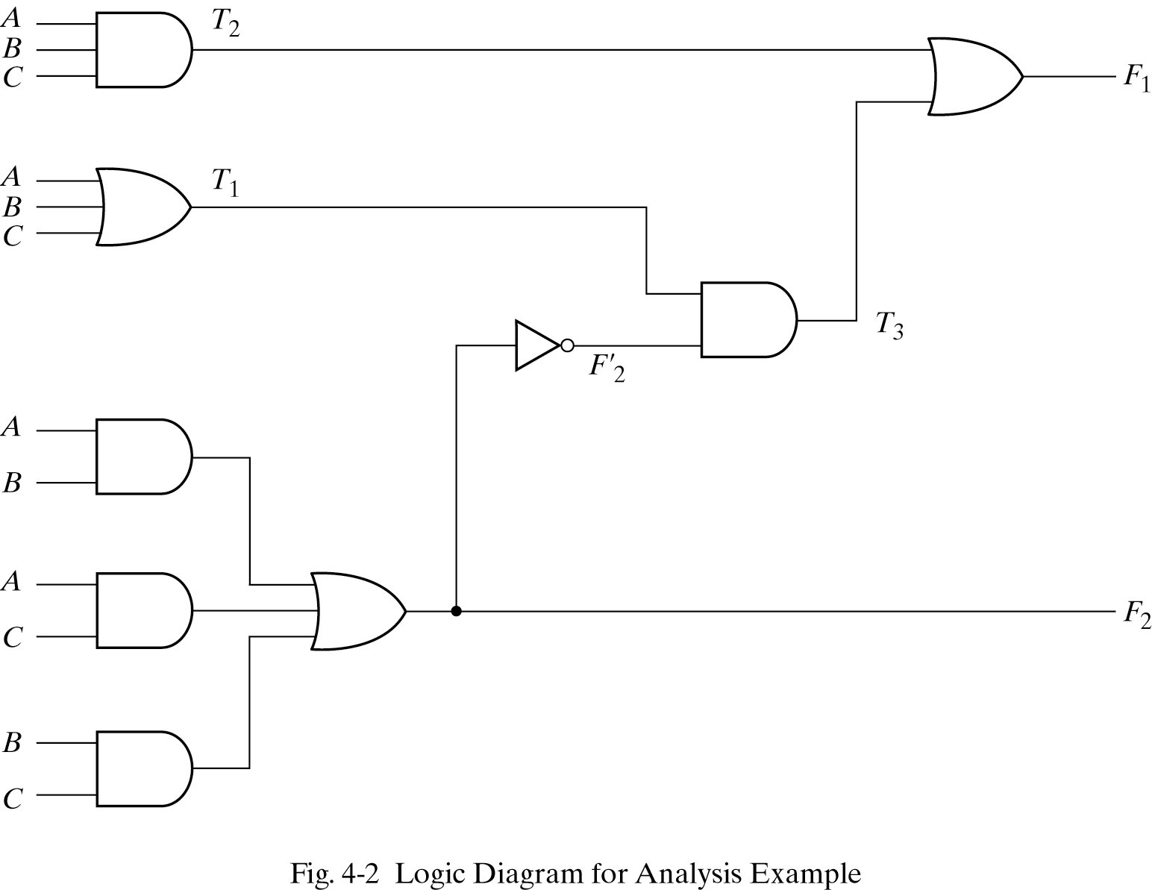
Testbench: Example 2

Slide 19
Testbench: Example2
//HDL Example 4-10
//------------------------------------------
//Gate-level description of circuit of Fig. 4-2
module analysis (A,B,C,F1,F2);
input A,B,C;
output F1,F2;
wire T1,T2,T3,F2not,E1,E2,E3;
or g1 (T1,A,B,C);
and g2 (T2,A,B,C);
and g3 (E1,A,B);
and g4 (E2,A,C);
and g5 (E3,B,C);
or g6 (F2,E1,E2,E3);
not g7 (F2not,F2);
and g8 (T3,T1,F2not);
or g9 (F1,T2,T3);
endmodule
//Stimulus to analyze the circuit
module test_circuit;
reg [2:0]D;
wire F1,F2;
analysis fig42(D[2],D[1],D[0],F1,F2);
initial
begin
D = 3'b000;
repeat(7)
#10 D = D + 1'b1;
end
initial
$monitor ("ABC = %b F1 = %b F2 =%b ",D, F1, F2);
endmodule
Simulation Log:
ABC = 000 F1 = 0 F2 =0
ABC = 001 F1 = 1 F2 =0
ABC = 010 F1 = 1 F2 =0
ABC = 011 F1 = 0 F2 =1
ABC = 100 F1 = 1 F2 =0
ABC = 101 F1 = 0 F2 =1
ABC = 110 F1 = 0 F2 =1
ABC = 111 F1 = 1 F2 =1

